Slide 1
Opportunity Framing: Cash Preservation in the Lighting space
Sani Aminu
Field Team Leader

Slide 2
Objective
“Achieve 43% cash preservation on spend in the lighting space
without compromising on safety and quality”.

Slide 3
Reasons for Change
Budget: OPEX cuts constraining cash availability to fully execute lighting scope(s) in SCiN installations.
Safety: Resultant poor illumination has personnel safety and asset security implications.
3Cs: The macro-economic impact of the pandemic and the need to preserve cash.

Slide 4
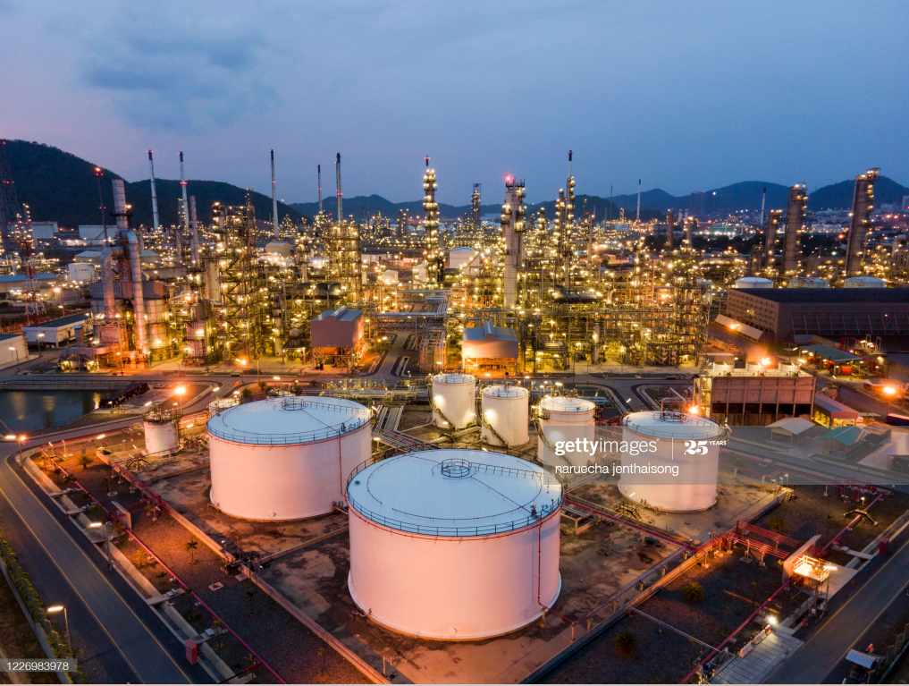
Background/Important points
Lighting and illumination is an integral part of SCiN installations.
They are important for the safety and security of personnel and asset.
They cost a lot of money during both project and operate phases.
Most prominently used manufacturer type in SCiN is CEAG. Other types used include STAHL and Chalmit (Bonga).
Fittings are Ex rated- higher rated fittings cost more than lower rated fittings.
For their prominence in SCiN CEAG fittings are stocked with material numbers- 1090001429 & 1000160195.
Items also supplied through Maintenance Execution.
Items are rated for use in both Zone 1 & 2.
At varying levels each installation has three zone classifications- 0, 1 and 2.

Slide 5
Opportunity
Select/replace lighting fitting according to area classification.
Use of Exe for Zone 1.
Use of ExN for Zone 2.
Use industrial fittings for non-classified, perimeter areas and road networks.
Enter into price agreement with CEAG OEM if not in place. If in place, ensure consistent usage by buyer(s) in C&P.

Slide 6
Opportunity Valuation- Do nothing scenario (DNS)
Assumptions
Cost of 4ft CEAG fitting pole/ceiling mounted- $1400/$1200 respectively.
Quantity of 4fts procured/year 1000 pole/200 ceiling fittings.
20% cost saving with OEM price agreement.
Outcomes
DNS
Total spend/year: $1.64m
DNS with Price Agreement
Total spend/year: $1.313m
Saving on strategy: $328K

Slide 7
Opportunity Valuation- Use of fit-for-zone fittings (FFZ)
Assumptions
Zone lighting requirement- Zone 1 (15%), Zone 2 (50%), Non-classified (35%).
Zone 1- 150 pole, 30 ceiling @ $1400 & $1200 respectively.
Zone 2- 500 pole, 100 ceiling @ $850 &$700 respectively.
Non-classified- 350 pole, 70 ceiling @$500 & $450.
20% cost saving with OEM price agreement.
Outcomes
Total spend/year with FFZ - $948K.
Total spend/year FFZ + price agreement- $758K.
Savings from use of price agreement- $189.5K.
Strategy savings on DNS+ Price agreement- $555K.

Slide 8
Summary Table
S/N | Options | Cost Implication/yr | Cost Saving vs DNS
1 | DNS | $1.64m
2 | DNS with PA | $1.313m | $327k
3 | FFZ | $948k | $692k
4 | FFZ with PA | $758k | $882k

Slide 9
Recommendations/Conclusion
Adopt the fit-for-zone fittings (FFZ) strategy for its cash preservation potential (43%) and the opportunity it affords to work within the prevailing cash constraint to deliver full lighting scope in SCiN installations.

